Slide 1
Complete Versus Culprit-Only Revascularization Strategies to Treat Multivessel Disease After Early PCI for STEMI
NEJM,SEP 1-2019
COMPLETE TRAIL

Slide 2
INTRODUCTION
Primary PCI is the preferred method of reperfusion for patients with STEMI.
Multivessel coronary artery disease with additional angiographically significant lesions.
Routinely revascularize these nonculprit lesions is dilemma.

Slide 3
METHODOLOGY
The COMPLETE trial - multinational, randomized trial.
Patients with STEMI and multivessel coronary disease were randomized to complete revascularization (n = 2,016) versus culprit-only revascularization (n = 2,025).
Complete revascularization group- staged PCI during the index hospitalization or after hospital discharge (within 45 days).

Slide 4
Total number of enrollees: 4,041
Duration of follow-up: 3 years
Mean patient age: 62 years
Percentage female: 19%
Percentage with diabetes: 19%

Slide 5
INCLUSION CRITERIA
Patients with STEMI and multivessel disease – included if they could undergo randomization within 72 hours after successful culprit-lesion PCI.

Slide 6
EXCLUSION CRITERIA
An intention before randomization to revascularize a nonculprit lesion.
A planned surgical revascularization.
Previous coronary-artery bypass grafting surgery.

Slide 7
RANDOMIZATION
Eligible patients - randomly assigned as complete revascularization or culpritlesion-only revascularization according to a computer-generated randomization list with blinding to trial center.
Complete-revascularization group-routine staged PCI.
culprit-lesion-only PCI -guideline-based medical therapy.

Slide 8
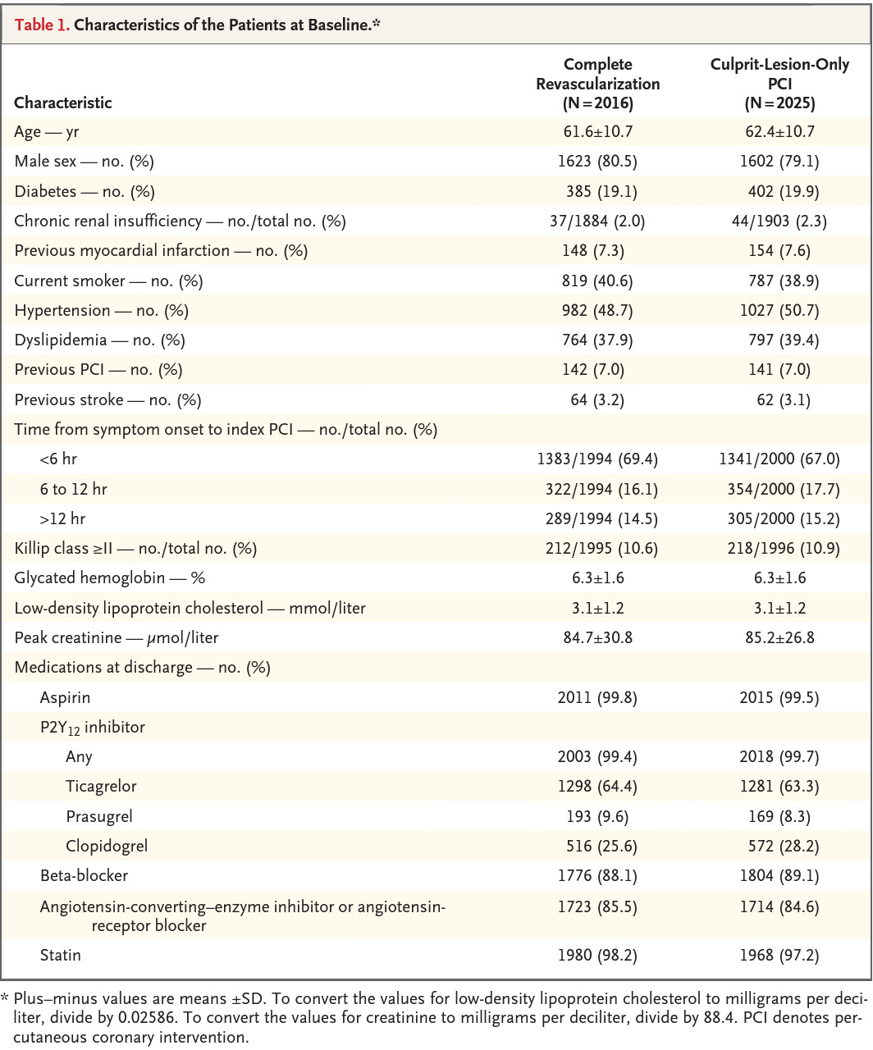

Slide 9
OUTCOMES
PRIMARY
Cardiovascular death
New myocardial infarction.
SECONDARY
Death from Cardiovascular causes
New myocardial infarction
Ischemia-driven revascularization.
SAFETY
Major bleeding
Contrast-associated acute kidney injury.

Slide 10
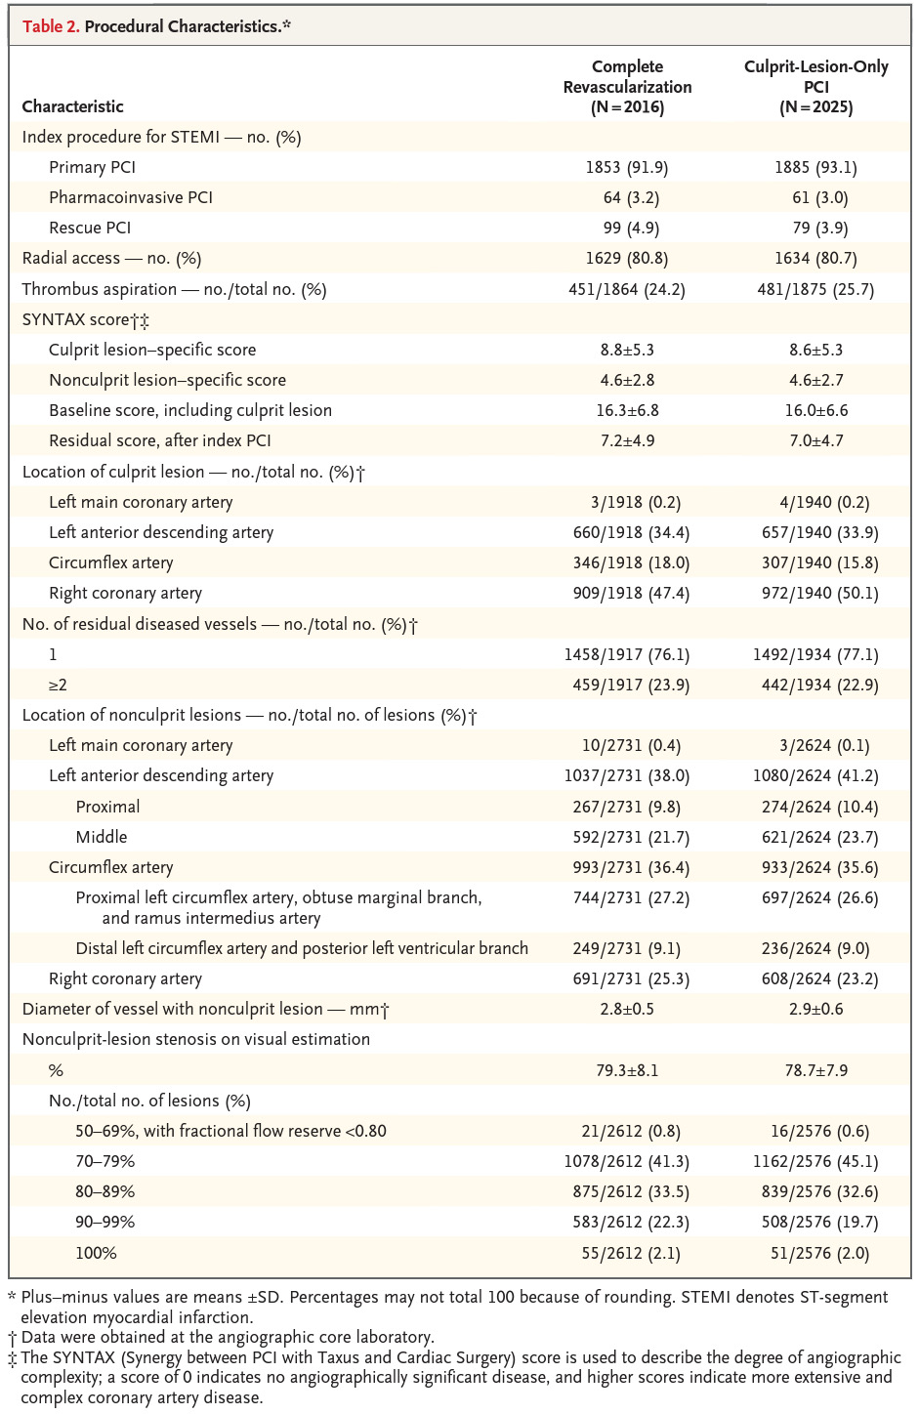

Slide 11
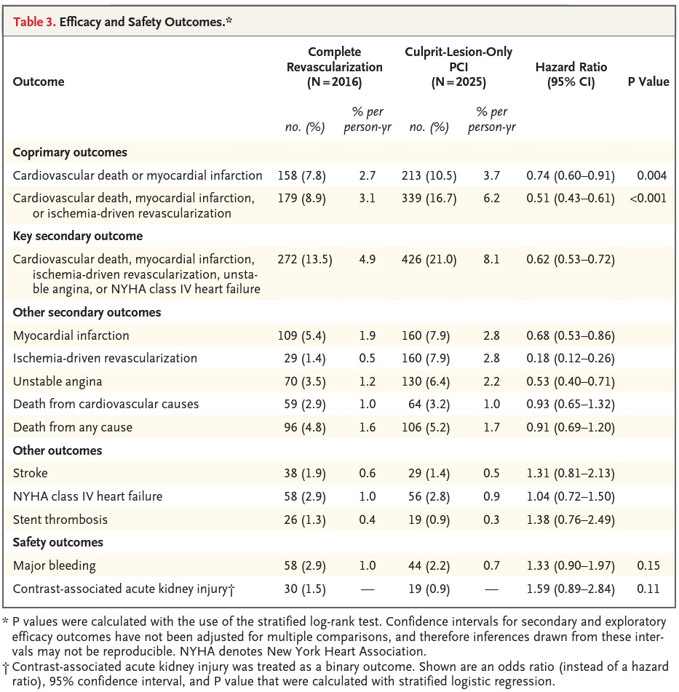

Slide 12
CONCLUSION
Complete revascularization was associated with a reduction in cardiovascular death or MI. This was accomplished without an significant increase in major bleeding or contrast-induced nephropathy.

Slide 13
1) Int J Cardiol. 2017 Feb 1;228:844-852. doi: 10.1016/j.ijcard.2016.11.186. Epub 2016 Nov 10.
Complete revascularization versus culprit-only revascularization in ST-segment elevation myocardial infarction and multivessel disease patients undergoing primary percutaneous coronary intervention: A meta-analysis and trial sequential analysis.

Slide 14
Eight RCTs with 2060 patients.
The follow-up was 6-38months.
ICR reduced MACE, all-cause death and/or MI, non-fatal MI, and repeat revascularization.
SCR reduced only MACE.
Contrast-induced nephropathy, major hemorrhage, and stroke incidences were not different between CR and COR.

Slide 15
2) JACC Cardiovasc Interv. 2017 Feb 27;10(4):315-324. doi: 10.1016/j.jcin.2016.11.047.
Complete or Culprit-Only Revascularization for Patients With Multivessel Coronary Artery Disease Undergoing Percutaneous Coronary Intervention: A Pairwise and Network Meta-Analysis of Randomized Trials.

Slide 16
4 different revascularization strategies - complete revascularization at the index procedure, staged procedure during the hospitalization, staged procedure after discharge or culprit-only revascularization.
RESULT ;-A total - 2,285 patients.
CR (i.e., at the index procedure or as a staged procedure) was associated with a lower risk of (MACE).
The risk of all-cause mortality and spontaneous reinfarction was similar.

Slide 17
3) Complete Revascularization Versus Culprit Lesion Only in Patients With ST-Segment Elevation Myocardial Infarction and Multivessel Disease( 8, 2019) J Am Coll Cardiol Intv 2019;12:721–30)
A DANAMI-3–PRIMULTI Cardiac Magnetic Resonance Substudy

Slide 18
Complete FFR-guided revascularization in patients with STEMI and multivessel disease did not affect final infarct size, LV function, or remodeling compared with culprit-only PCI.

Slide 19
THANK YOU

Slide 20
ECG & CASE DISCUSSION
19-year-old man presents to an ED with an episode of shortness of breath and syncope. He was mowing his lawn when he began to feel short of breath and light-headed, causing him to go inside where he reportedly "passed out."
He was unresponsive but did not exhibit any seizure-like activity and he quickly regained consciousness.
He reports having palpitations, described as irregular, forceful beats, and fatigue for the past week, but the rest of his review of systems is grossly normal.
His vitals are: temperature, 96.7°F (35.9°C);
pulse rate between 40 and 120 bpm;
respiratory rate, 16 breaths per minute, blood pressure, 102/46 mm Hg; and oxygen saturation of 96% on room air. His physical examination is notable for an irregular tachycardia and multiple, bilateral macular erythematous lesions with central pallor on his thighs.

Slide 21
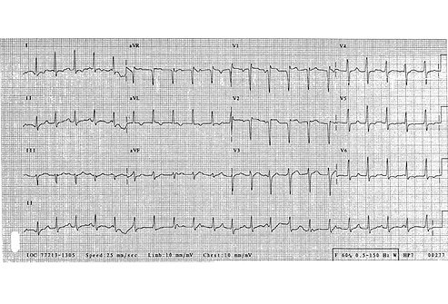

Slide 22
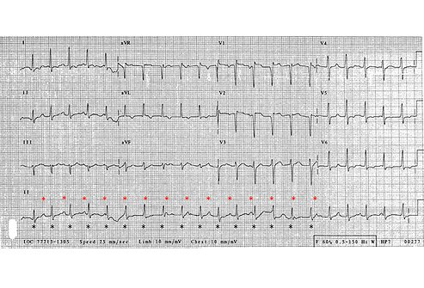

Slide 23
The patient is suffering from disseminated Lyme disease. The diagnosis is made based on his history,skin lesions,and ECG findings. Approximately 8%-10% of patients with Lyme disease have cardiac involvement.
Presenting symptoms may include light-headedness, palpitations, or syncope, and are typically caused by a conduction defect ranging from first-degree block to complete atrioventricular dissociation.

Slide 24
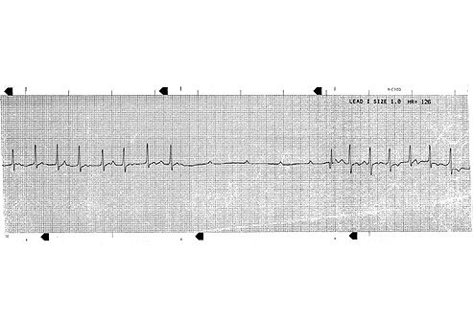

Slide 25
The rhythm strip - an interval of nonconducted P-waves indicative of complete heart block.
Fortunately, most conduction defects are reversible processes after treatment of the underlying infection.
Other cardiac manifestations of disseminated Lyme disease include myopericarditis, ventricular dysfunction, cardiomegaly, and pericardial effusion with possible tamponade.

